Slide 1
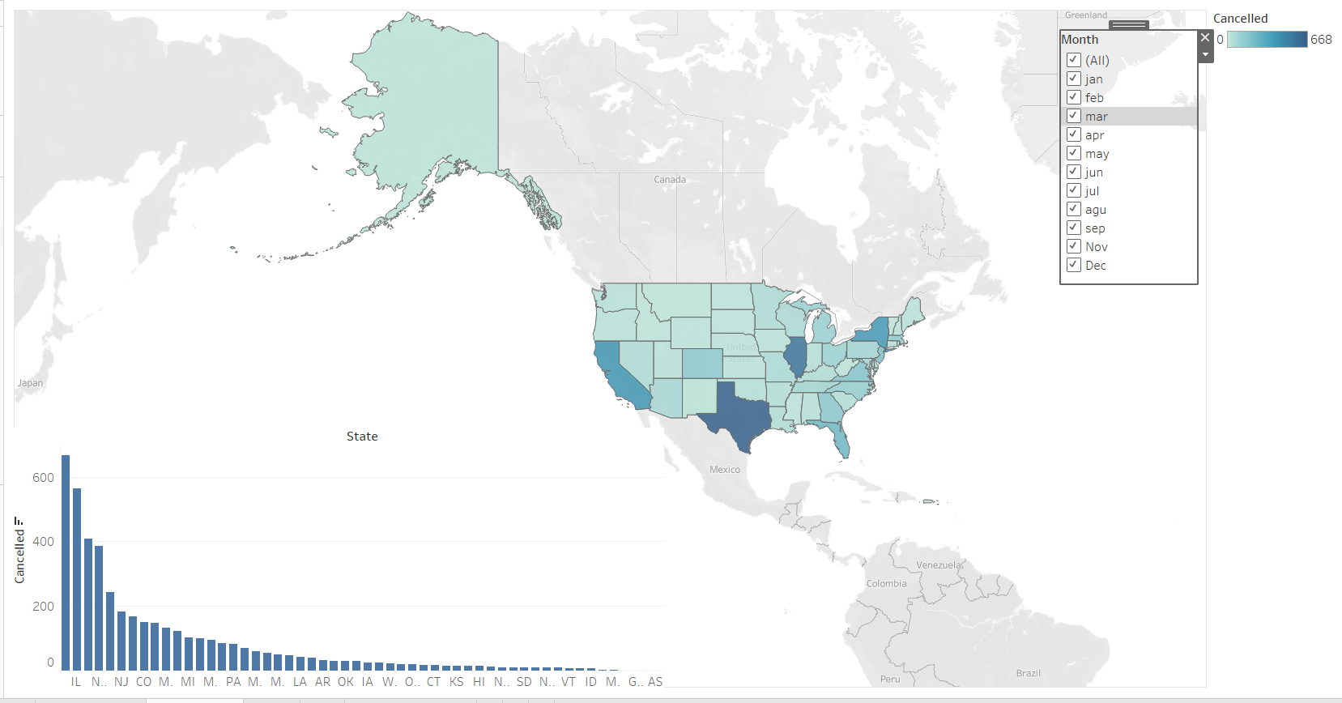
Q(1) which state has the most canceled flights?
Link: https://public.tableau.com/app/profile/ahmed.saad7711/viz/Tableauproject1_16396643931430/Dashboard1?publish=yes
Summary :The dashboard describes the states with the most canceled trips in the whole year ( January to December ). From the dashboard, we can say that the tx ( USA) is the most canceled trip during the year.Design : Design: I used dashboard here to display more that one chart ( maps and barchart )
Resources : https://www.kaggle.com/usdot/flight-delays/data

Slide 2
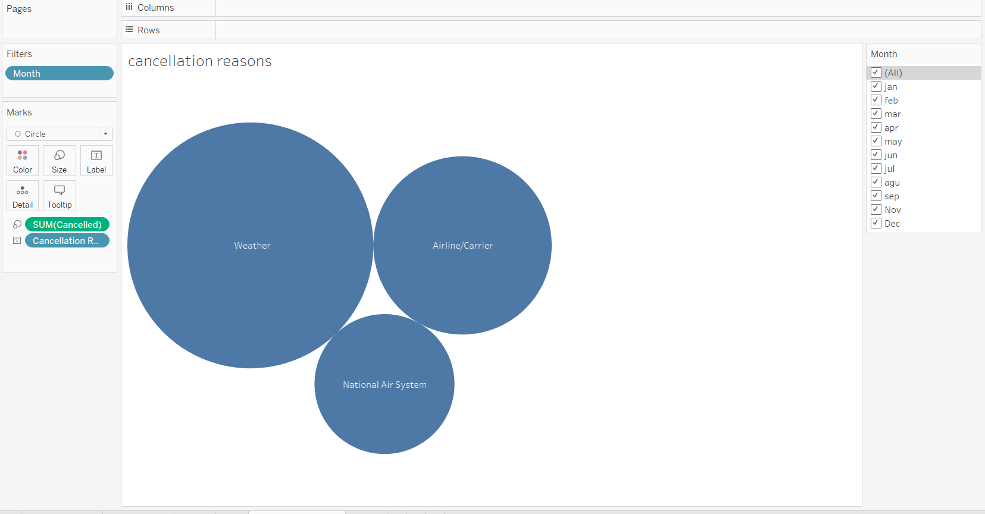
Q (2) what are the most common reasons for canceling flights ?
Link: https://public.tableau.com/app/profile/ahmed.saad7711/viz/reasons_project1/cancellationreasons?publish=yes
Summary :The figure describes the common reasons for canceling flights, and it focused on reasons ( weather, Airline/Carrier, National Air System ). From the figure, we can say that the most reason that leads to canceling the flight is the weather.
Design : I used packed bubbles here because the comparison is limited and shows the largest airline which has the largest number of delayed flights
Reasources : https://www.kaggle.com/usdot/flight-delays/data

Slide 3
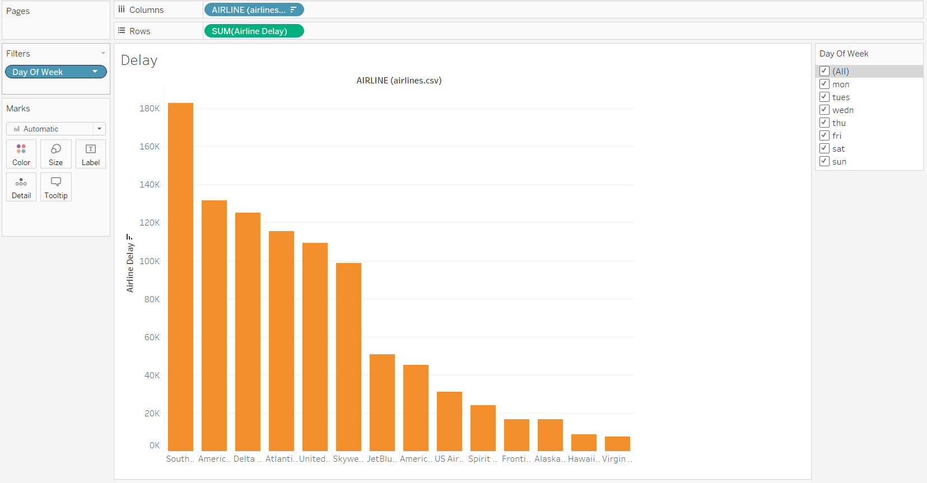
Q(3) what are the most airline company have delayed flights?
Link: https://public.tableau.com/app/profile/ahmed.saad7711/viz/delayproject1/Delay?publish=yes
Summary: The figure show that the south east airline company is the most company its filights delayed in a year
Design : I used a bar chart here because the comparison is limited and shows the largest airline which has the largest number of delayed flights
Reasources : https://www.kaggle.com/usdot/flight-delays/data

